Slide 1

Adults’ Income Dataset
Insights on the demographics of the adults’ census, income and factors influencing it

Slide 2

Adults’ Income Dataset
The dataset includes different features like age, gender, race, marital status, relationship, occupation, work class, and income.
We try to answer the following question:
Does income differ with other demographic features?
In the analysis, we explore which gender is the highest paid, which country earns the highest income and which occupation and work class only earns low income.

Slide 3
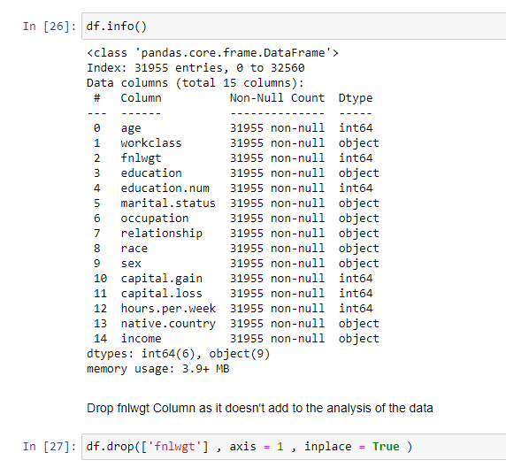
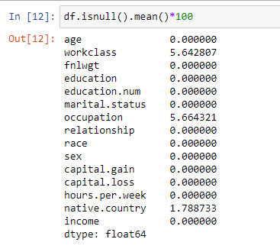
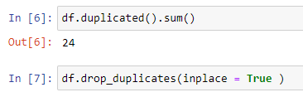
Adults’ Income Dataset
To analyze this dataset, I used different python libraries like pandas, numpy, plotly, matplotlib, seaborn
I used power BI to create a dashboard.
First, to clean the data, I dropped duplicates, looked for missing values, filled them, and dropped features that won’t contribute to the analysis.

Slide 4
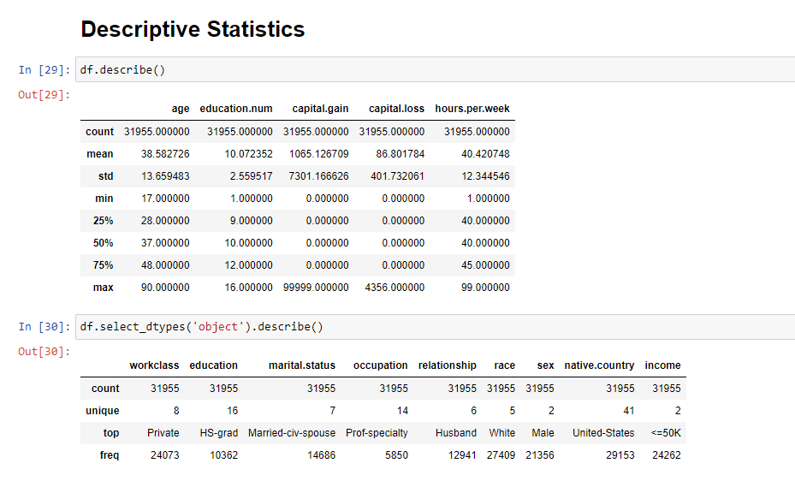
Adults’ Income Dataset
Second for the analysis, I began by showing a statistics summary for all variables
Then went into some of the variables for the univariate analysis
And lastly was the multivariate analysis to answer our question.

Slide 5
Age distribution
Average Age is 38.5
Age feature is skewed to the left, and has some outliers
Maximum age is 90 (outlier) and minimum age is 17
Mode is 36

Slide 6
Gender distribution
67% of the data were males and 33% were females.
The male gender dominated the dataset

Slide 7
race distribution
The dominant race was white 86%.
Black followed with only 9%.
Indian, Asian, and other made 1, 3, and 1% of the dataset.
The domination of white and the minimum representation of the other races might affect the analysis of its effect on income.

Slide 8
occupation
Top occupation was Prof-Specialty while the least mentioned occupation was armed-forces.

Slide 9
Marital status
Married, Never Married and Divorced were the highest three categories.

Slide 10
Education level
HS-grad is the most repeated variable, followed by Some College then Bachelors.
The figure shows the top 8 mentioned edu levels.

Slide 11
Work class
75% of the dataset worked in a private class.
0.02% and 0.04% never worked or work without pay.
11% are self employed and 13% work in government.

Slide 12
income distribution
Income is divided into 2 categories: =<50K which is low income and >50k which is high income.
Only 24% of the dataset earned high income.

Slide 13
Income distribution by gender
30% of males earn high income (<50K) while only 10% of females earn high income.
Income can be affected by gender as males are more likely to get high income than females.

Slide 14
Income Distribution by race
To mitigate some of the poor representation effect, we examined income percentages within the same race and will compare the percentages.
The race that’s paid more high income was Asian, followed by White then Black.

Slide 15
income distribution vs working hours
Average working hours per week is 40 hrs.
21% of the people working 40hrs earn high income.
The most people earning more than 50K is those who work 50 hrs per week (45%)
However, there’s no trend between income and working hours.

Slide 16
income distribution in the private work class
In the private work class, 21% earn high income >50K.
While the rest earn low income.

Slide 17
income distribution in work classes
55% of the self employed earn high income, and 38% of those working in local gov.
We can see that working in different classes can affect your income. There’s a higher chance you will earn high income if you work as self employed compared to government.

Slide 18
income distribution by occupation
Almost all working in the service sector (house service, other service, cleaners) earn only low income.
Prod Specialty and Exec Managerial occupations earn high income the most.
There’s a low chance to earn high income if you work in farming or fishing.

Slide 19
income distribution by level of education
People with bachelor's degree earn high income by a greater chance than the other education levels.
Furthermore, if you have a masters or a doctorate or if you are prof-school, earning a high income is more probably than earning low income.

Slide 20
income distribution in the us
Since the US was the dominant country in the dataset, I analyzed it separately.
24.5% earn high income in the US,
While the rest earn low income.

Slide 21
income distribution in the rest of the world
People in France, India, Iran, and Japan earn more high income than the other countries (almost 40%)
People in Netherlands only earn low income.
There’s a very low chance to earn high income if you’re in Colombia, Guatemala, Mexico, and Nicaragua.

Slide 22
summary
Income is affected by gender, work class, occupation, education level and location.
Race and working hours can affect income but there’s no obvious trend.

Slide 23
Github Link
https://github.com/Afnan-Alaa/Adults-Income-Dataset.git

Slide 24
Dashboard Link
https://app.powerbi.com/groups/me/dashboards/ccb4ad7e-2177-4547-bd8a-808d6aeded8f?ctid=77255288-5298-4ea5-81aa-a13e604c30ac&pbi_source=linkShare

Slide 25

Thank you

